Slide 1
PS Core Impact during NCC
Upgrade Activity

Slide 2
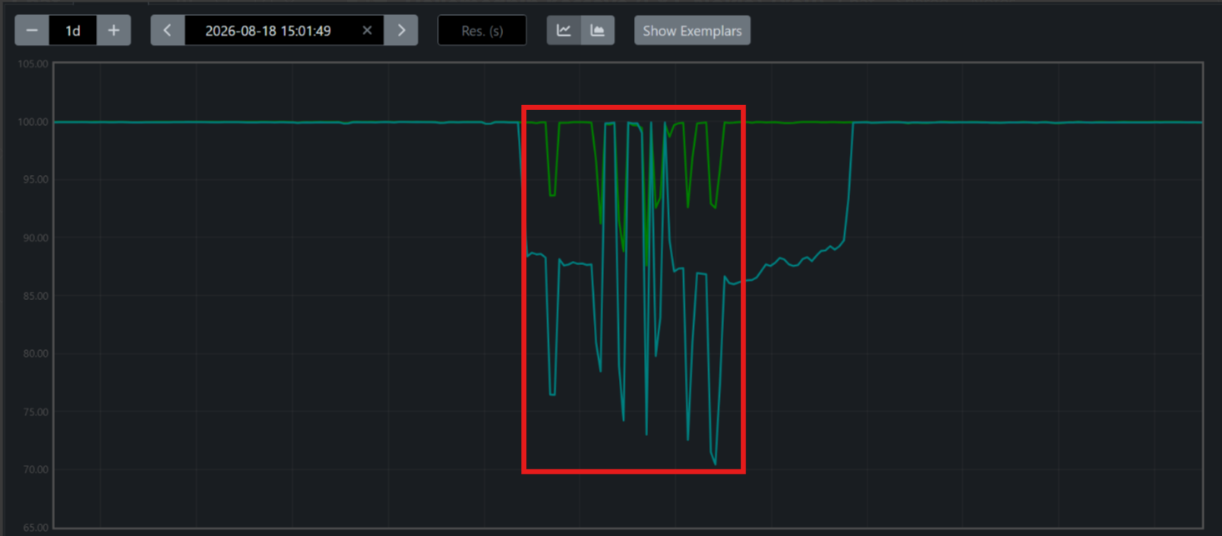
2026-08-18 01:22, 02:20, 02:49, 03:23, 03:35, 04:15, 04:44,
Sy SR and Gy on both MDC1 and MDC2 was impacted, Multiple dips were observed
during switch over time.
Sy SR

Slide 3
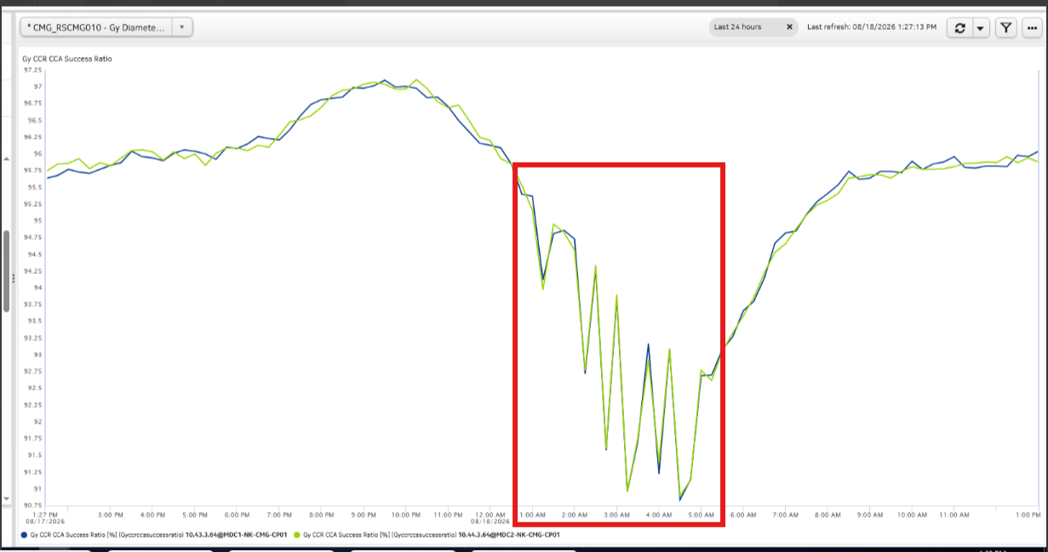
Gy Diameter

Slide 4
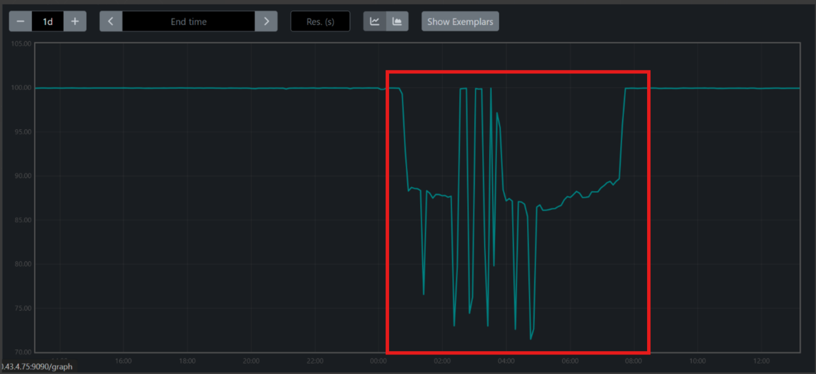
2026-08-18 00:48
2026-08-18 07:42
Specifically, for Sy STR, It was impacted when traffic was blocked from DRA side to MDC1 NCC, due to Diameter unknown session id failure cause. Subsequent dips was also observed during switchover time. It recovered fully in the morning when traffic was unblocked from DRA side.
Sy STR

Slide 5
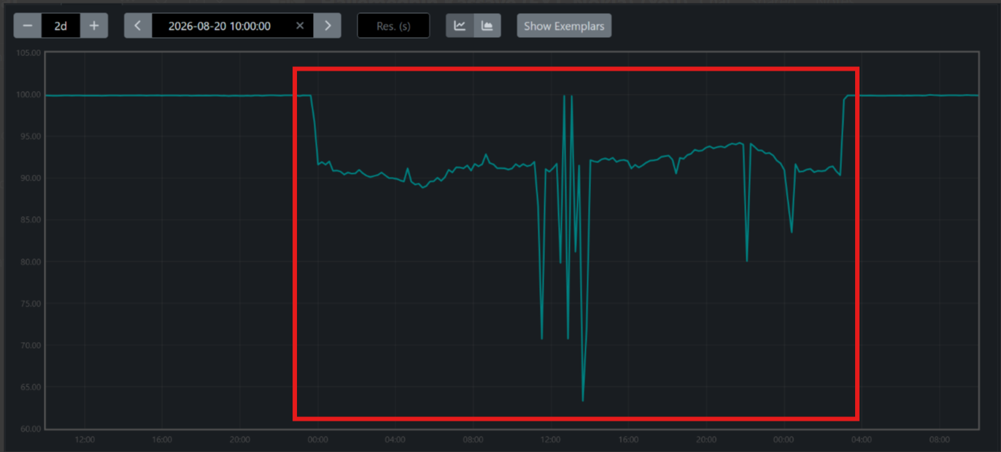
2026-08-18 23:49
2026-08-20 03:10
Observed dip on Sy STR, When traffic was blocked from DRA to MDC1 NCC
Recovered after traffic was unblocked from DRA.

Slide 6
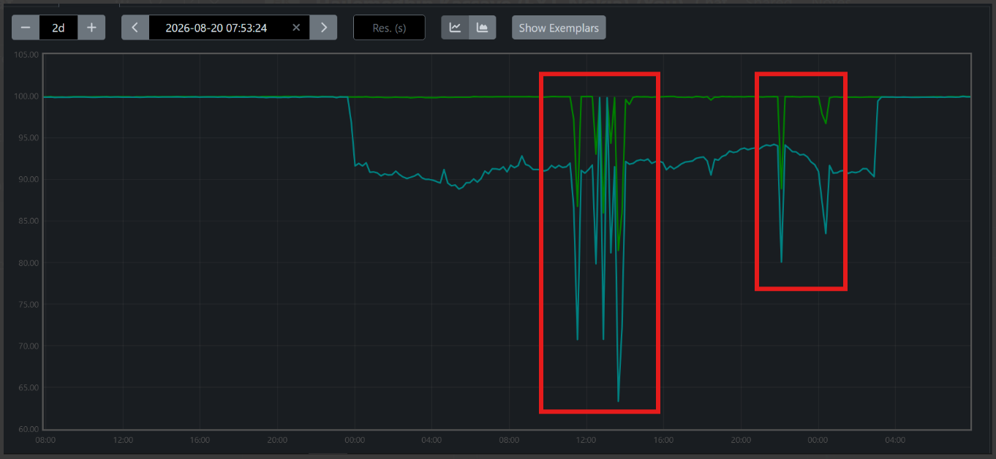
2026-08-19 11:20, 12:29, 12:52, 13:09, 13:38, 22:04,
2026-08-20 00:10
Sy SR and Gy on both MDC1 and MDC2 was impacted, Multiple dips were observed
due to MDC2 NCC SR being impacted (All part of ongoing activity).
Sy STR

Slide 7
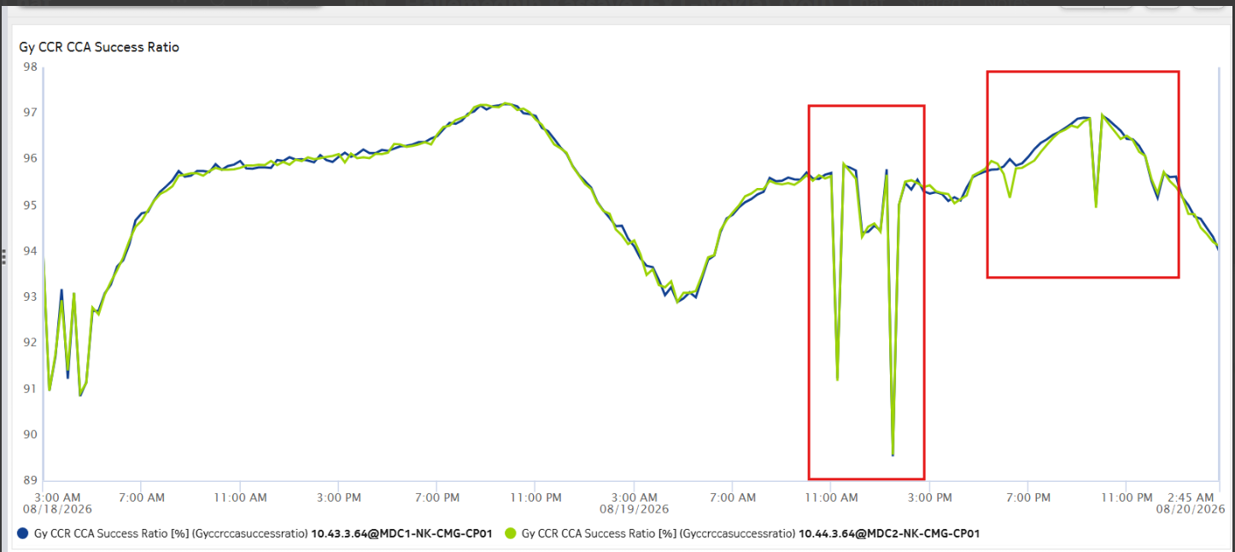
Gy

Slide 8
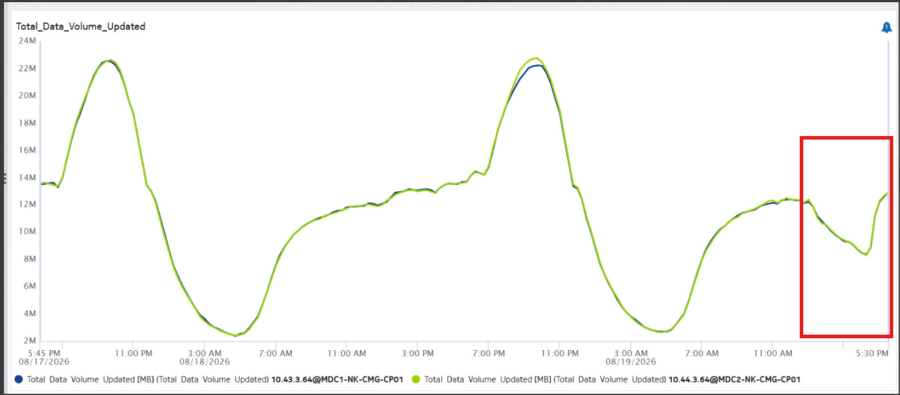
2026-08-19 14:15
Degradation on Total data volume, due to ongoing NCC upgrade activity, same time impact observed
from NCC side recharged impacted (Voucher based and voucher less).

Slide 9
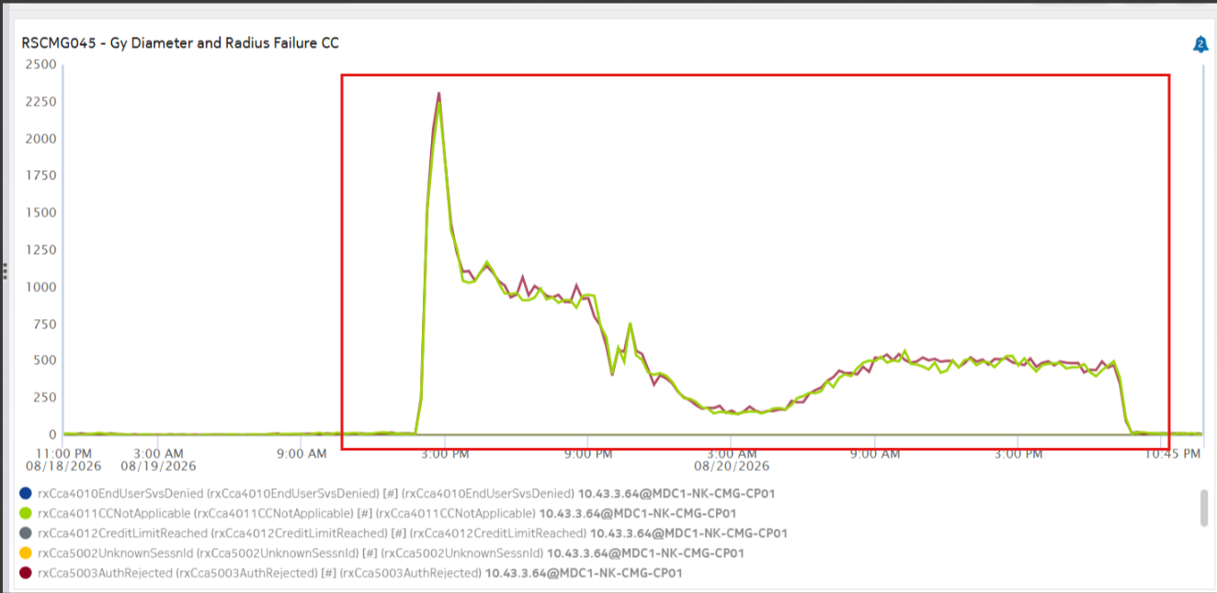
2026-08-19 14:00 - 2026-08-20 19:45
We observed an increase on Diameter RatingFailed Gy failure, which caused a slight degradation on Gy

Slide 10
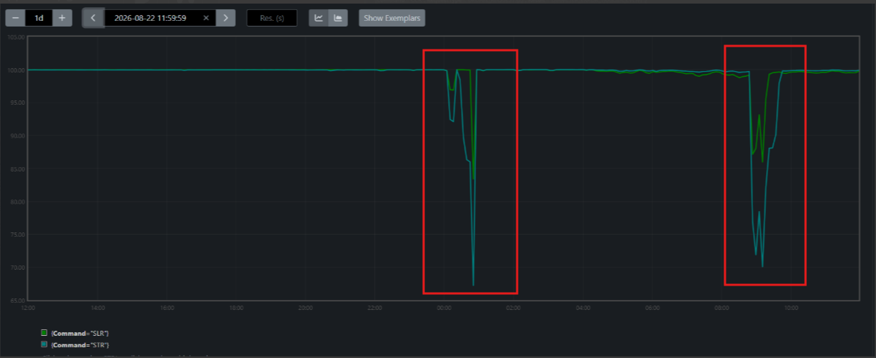
2026-08-22 00:10
2026-08-22 08:53
Multiple dips observed due to ongoing activity

Slide 11
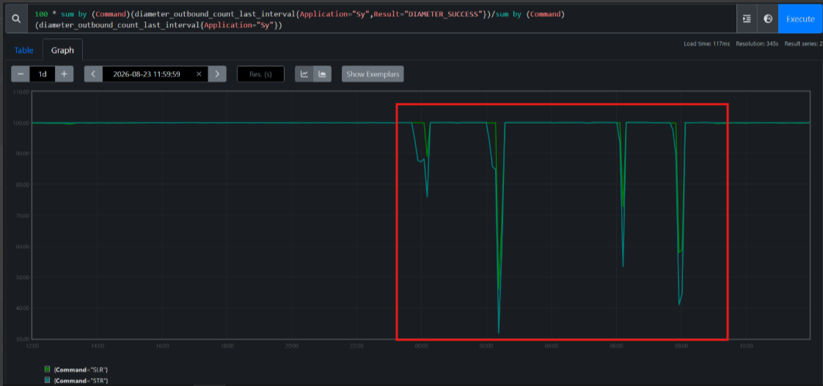
2026-08-22 23:52
2026-08-23 02:05
2026-08-23 06:06
2026-08-23 07:55
Multiple dips observed due to ongoing activity

Slide 12
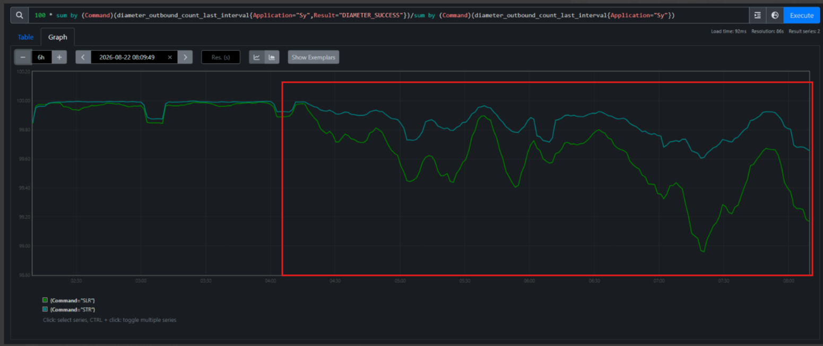
2026-08-22 04:33
Observed an increase on unable to comply and unknown session id increase on Sy failures
Due to this we observed a slight degradation on Sy SR
Sy SR

Slide 13
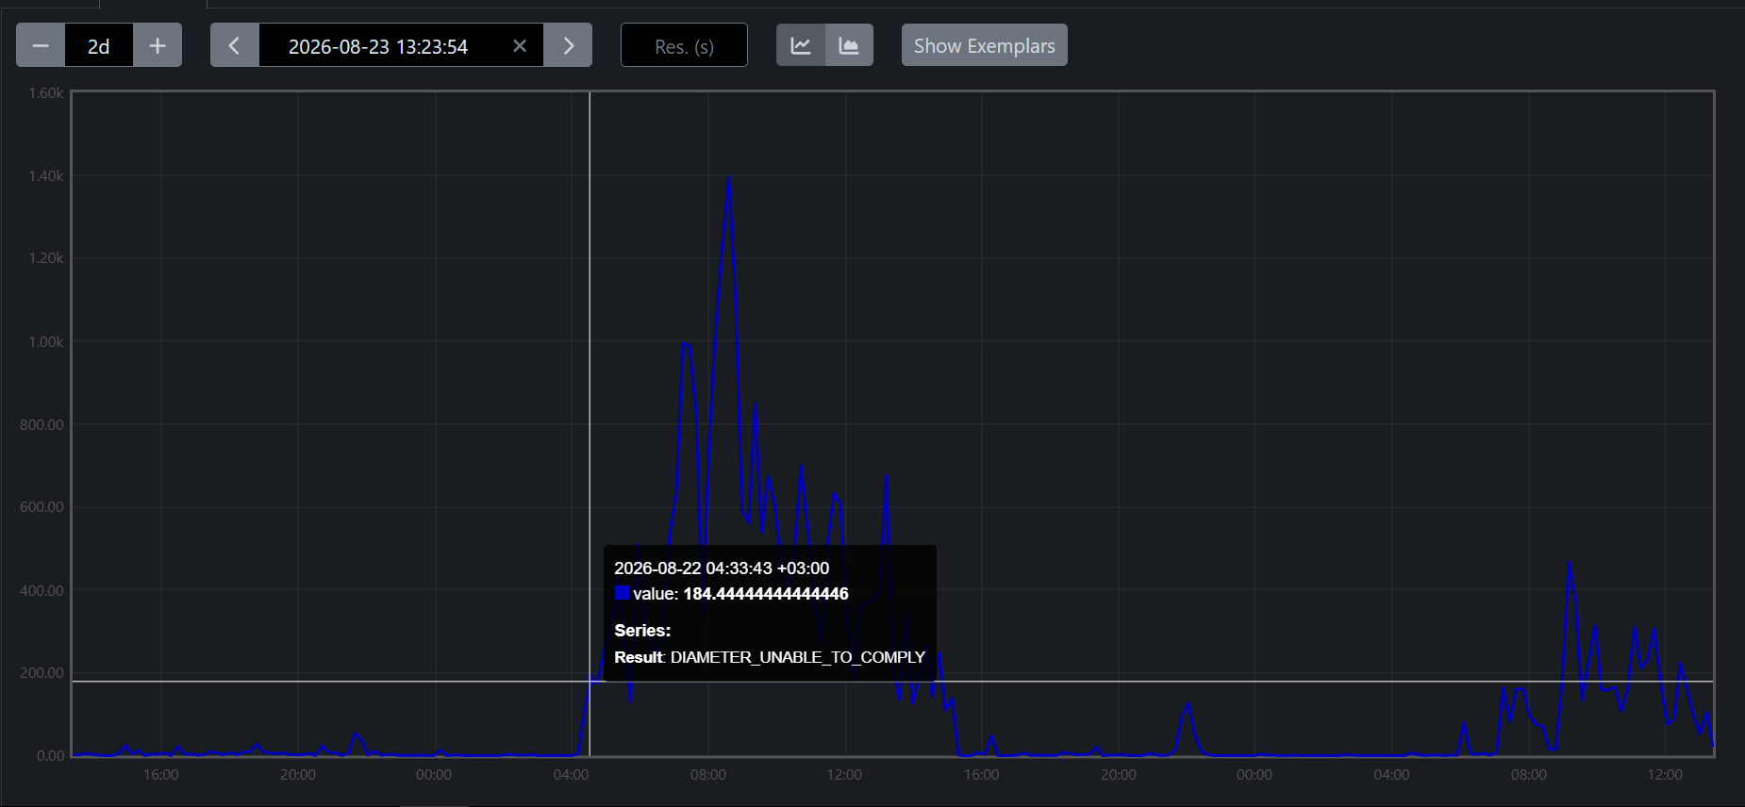
2026-08-22 04:33
Unable to comply

Slide 14
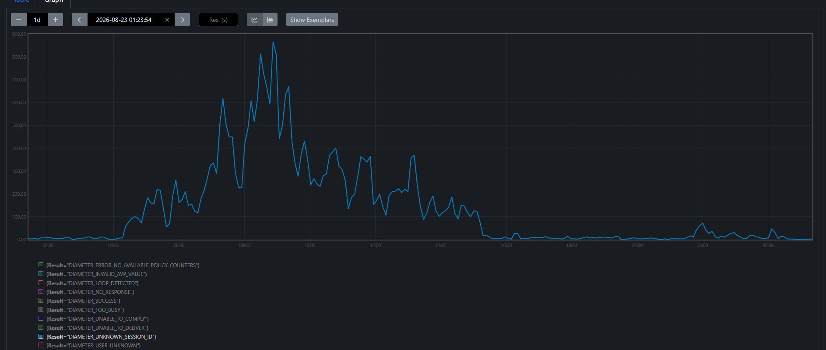
Unknown session ID

Slide 15
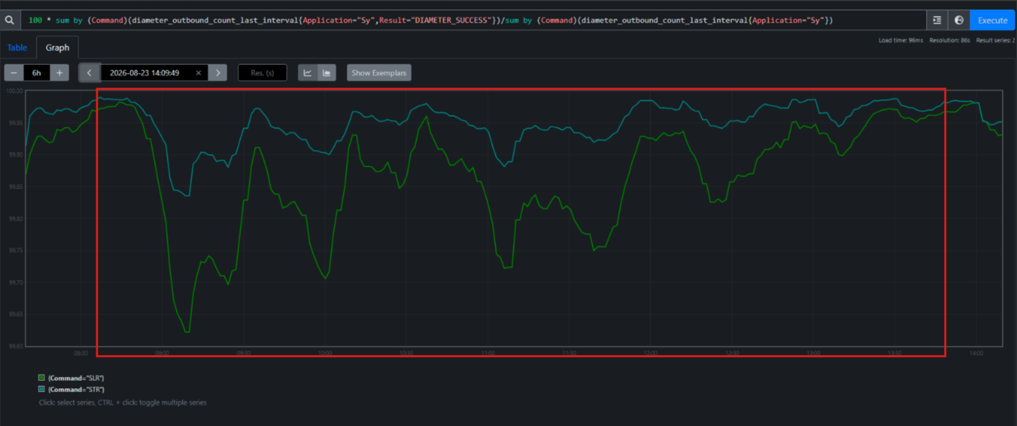
2026-08-23 07:14
Same observation as the pervious day, Increase on unable to comply and unknown session ID,
which resulted in a slight degradation on Sy SR

Slide 16
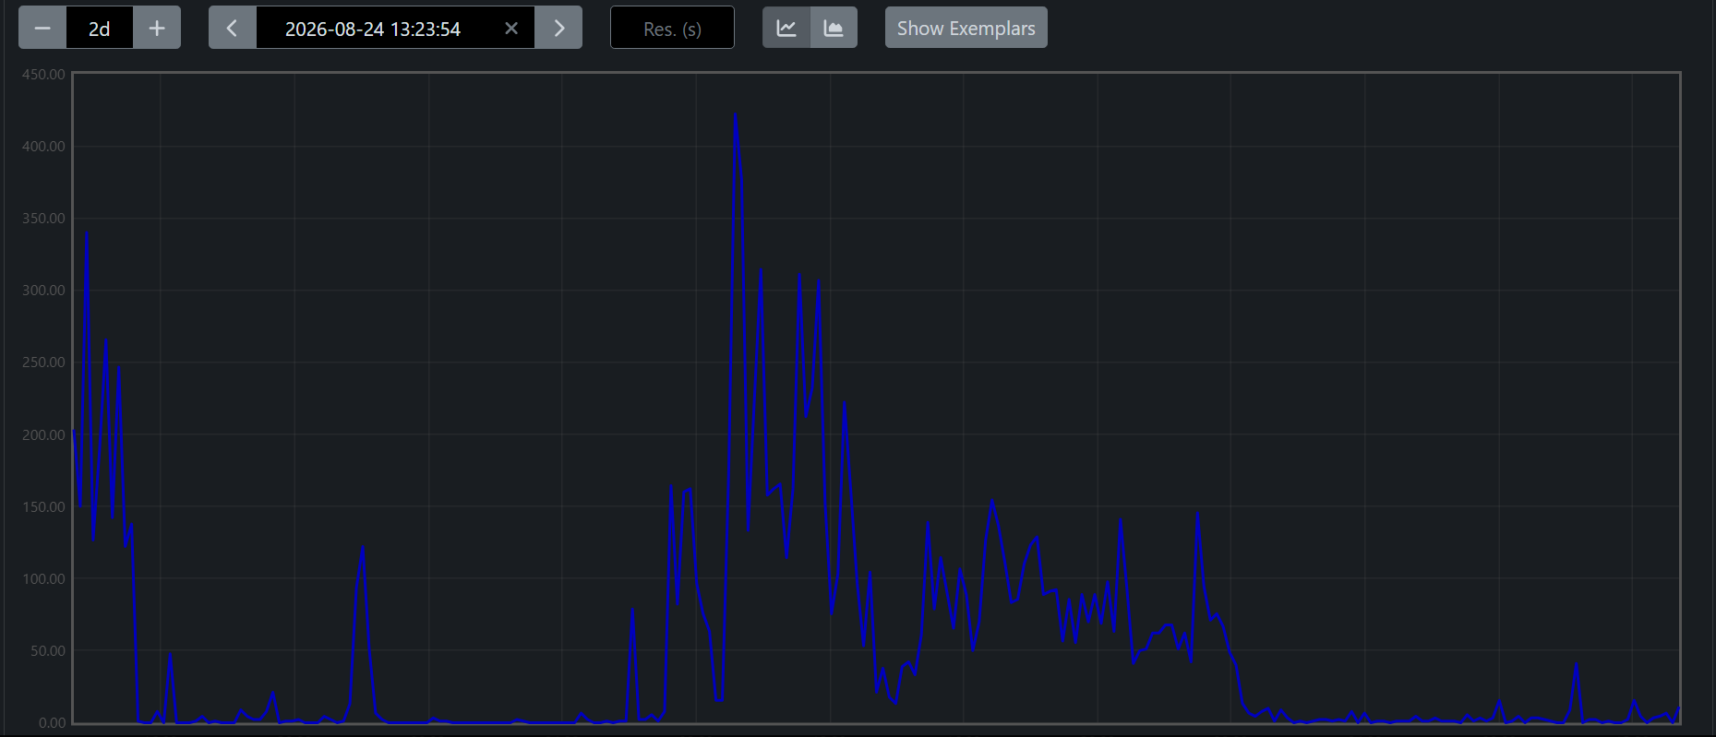
2026-08-23 07:14
Unable to comply

Slide 17
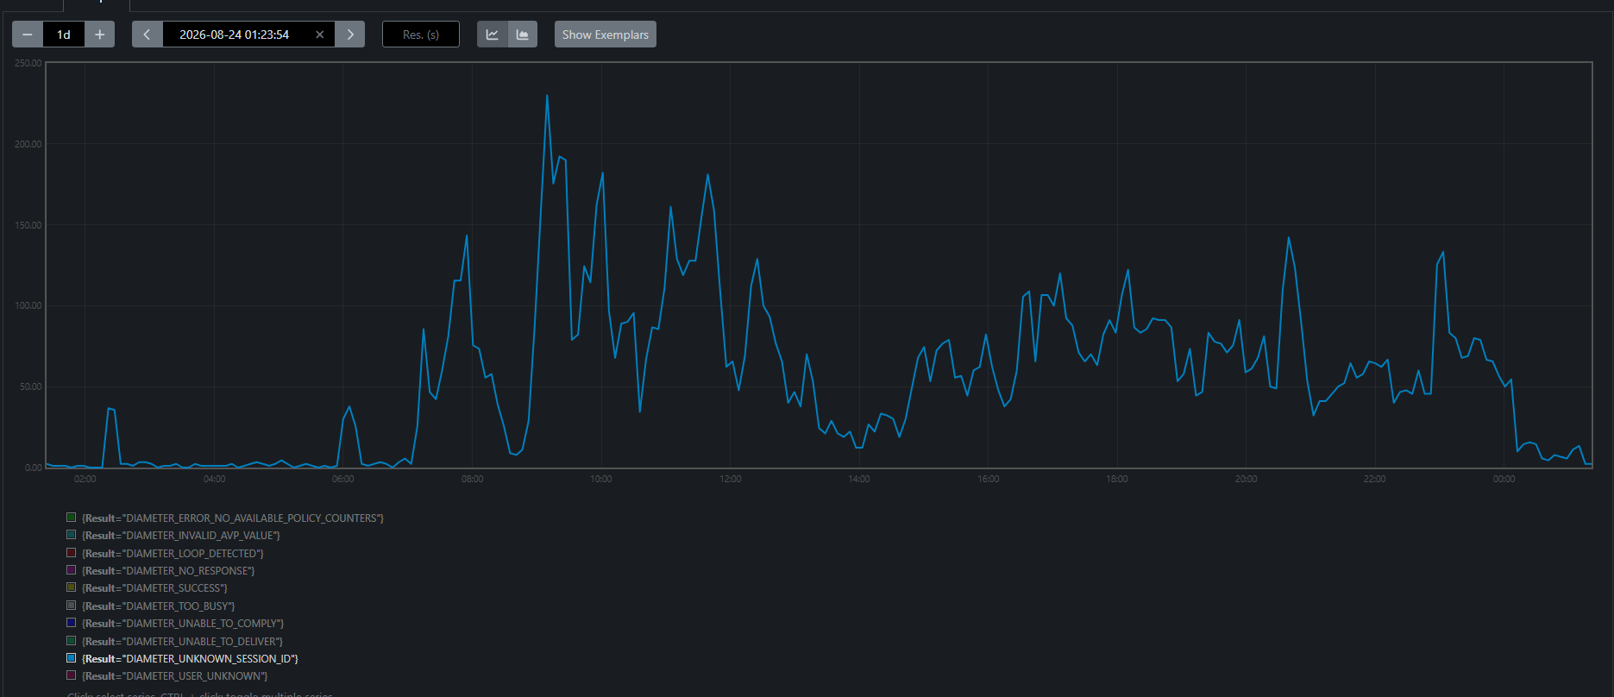
Unknown session ID

Slide 18
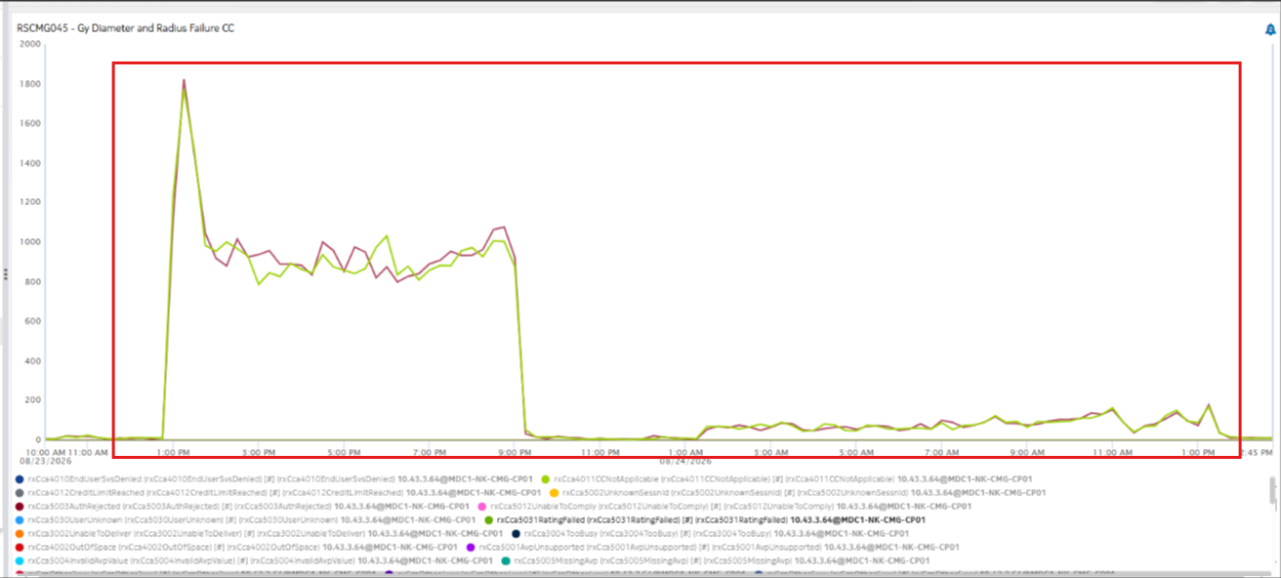
2026-08-23 13:00
2026-08-24 13:45
Again, RatingFailed error increased, which resulted a slight dip on Gy

Slide 19
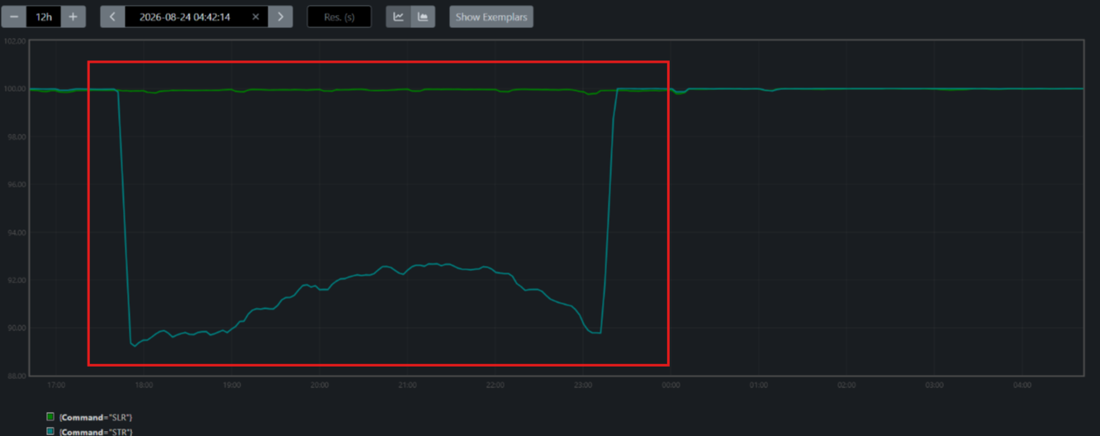
2026-08-23 17:44
Observed dip on Sy STR, Due to traffic being blocked from DRA and enabling inter-site connection from NCC

Slide 20
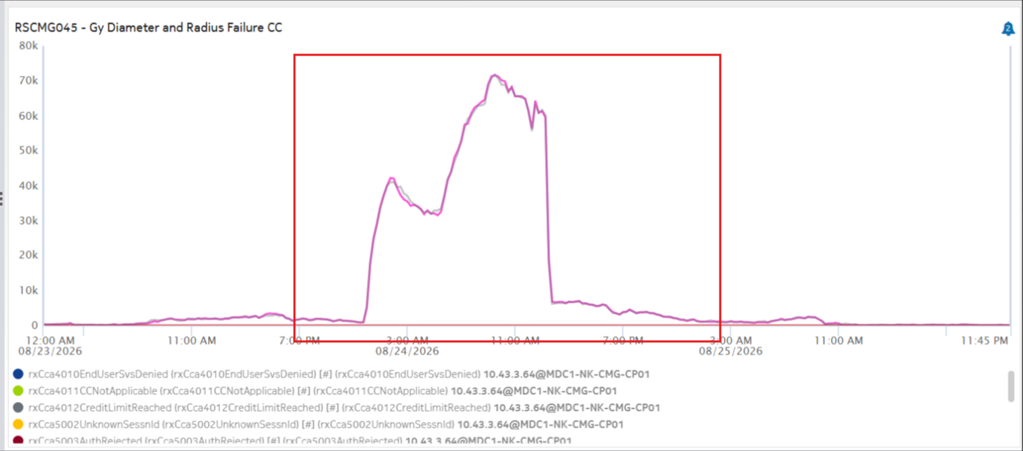
2026-08-24 00:00
2026-08-25 10:00
Observed an increase on unable to comply and unknown session ID, due to ongoing MDC2 NCC Upgrade activity,
which impacted Gy.

Slide 21
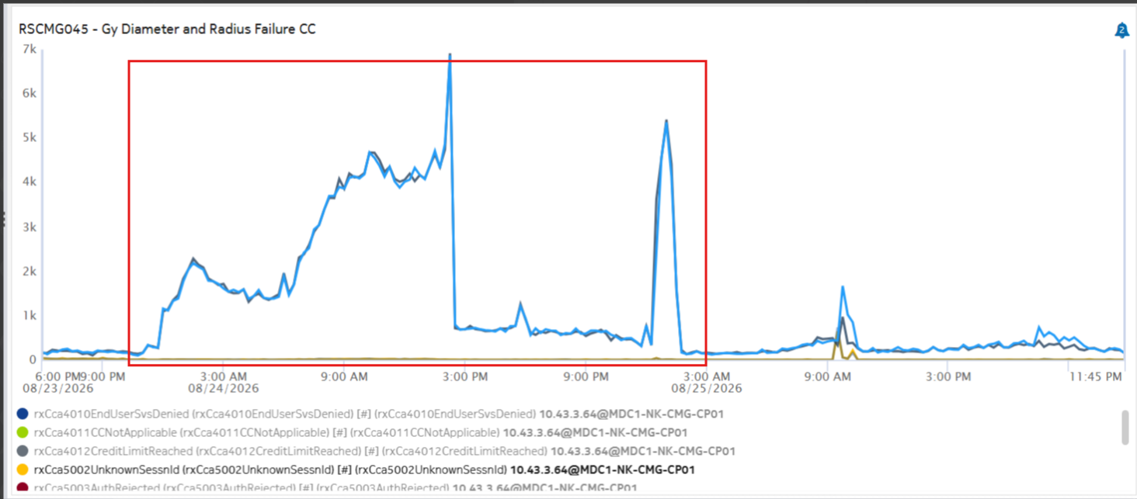
2026-08-24 00:00
2026-08-24 14:30

Slide 22
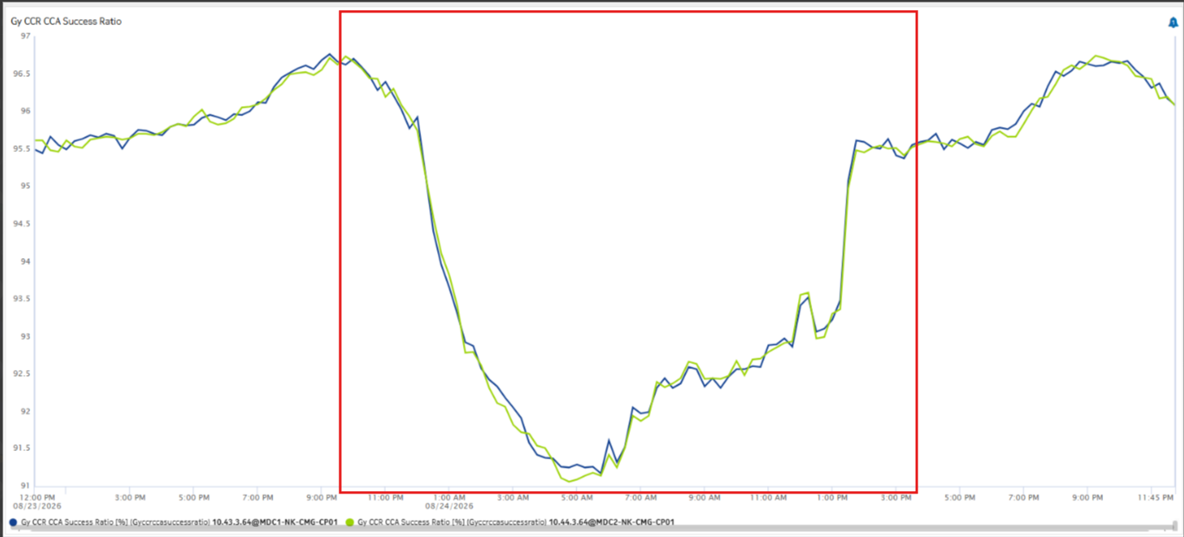
Gy

